Slide 1

SOFTWARE ENGINEERING
By
R.Vignesh,M.E(Ph.D)
Assistant Professor

Slide 2

Syllabus

Slide 3
Software Cost Estimation
For any new software project, it is necessary to know how much it will cost to develop and how much development time will it take.
These estimates are needed before development is initiated, but how is this done?
Several estimation procedures have been developed and are having the following attributes in common.
Project scope must be established in advanced.
Software metrics are used as a support from which evaluation is made.
The project is broken into small PCs which are estimated individually.
To achieve true cost & schedule estimate, several option arise.
Delay estimation

Slide 4
Used symbol decomposition techniques to generate project cost and schedule estimates.
Acquire one or more automated estimation tools.
Uses of Cost Estimation
During the planning stage, one needs to choose how many engineers are required for the project and to develop a schedule.
In monitoring the project's progress, one needs to access whether the project is progressing according to the procedure and takes corrective action, if necessary.

Slide 5
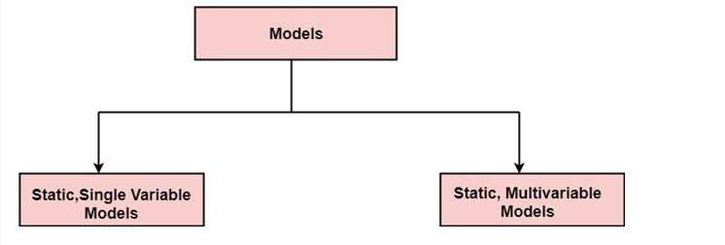
Cost Estimation Models
A model may be static or dynamic.
In a static model, a single variable is taken as a key element for calculating cost and time.
In a dynamic model, all variable are interdependent, and there is no basic variable.

Slide 6
Static, Single Variable Models: When a model makes use of single variables to calculate desired values such as cost, time, efforts, etc. is said to be a single variable model. The most common equation is:
C=aL^{b}
Where C = Costs L= size a and b are constants
The Software Engineering Laboratory established a model called SEL model, for estimating its software production.
This model is an example of the static, single variable model.

Slide 7
E=1.4L^{0.93} DOC=30.4L^{0.90} D=4.6L^{0.26}
Where E= Efforts (Person Per Month) DOC=Documentation (Number of Pages) D = Duration (D, in months) L = Number of Lines per code
Static, Multivariable Models: These models are based on method (1), they depend on several variables describing various aspects of the software development environment.
In some model, several variables are needed to describe the software development process, and selected equation combined these variables to give the estimate of time & cost. These models are called multivariable models.

Slide 8
WALSTON and FELIX develop the models at IBM provide the following equation gives a relationship between lines of source code and effort:
E=5.2L^{0.91}
In the same manner duration of development is given by
D=4.1L^{0.36}
The productivity index uses 29 variables which are found to be highly correlated productivity as follows:
Where W_{i} is the weight factor for the i^{th}variable and X_{i}={-1,0,+1} the estimator gives X_{i}one of the values -1, 0 or +1 depending on the variable decreases, has no effect or increases the productivity.

Slide 9
Example: Compare the Walston-Felix Model with the SEL model on a software development expected to involve 8 person-years of effort.
a)Calculate the number of lines of source code that can be produced.
b)Calculate the duration of the development.
c)Calculate the productivity in LOC/PY
d)Calculate the average manning
Solution:
The amount of manpower involved = 8PY=96persons-months
(a)Number of lines of source code can be obtained by reversing equation to give:
Then
L(SEL) = (96/1.4)1⁄0.93=94264 LOC
L (wl) = (96/5.2)1⁄0.91=24632 LOC

Slide 10
(b)Duration in months can be calculated by means of equation
D (SEL) = 4.6 (L) 0.26 = 4.6 (94.264)0.26 = 15 months D (W-F) = 4.1 L^{0.36} = 4.1 (24.632)0.36 = 13 months
(c) Productivity is the lines of code produced per persons/month (year)
(d)Average manning is the average number of persons required per month in the project

Slide 11
COCOMO Model
1)COCOMO Model
Boehm proposed COCOMO (Constructive Cost Estimation Model) in 1981.
COCOMO is one of the most generally used software estimation models in the world.
COCOMO predicts the efforts and schedule of a software product based on the size of the software.
The necessary steps in this model are:
Get an initial estimate of the development effort from evaluation of thousands of delivered lines of source code (KDLOC).
Determine a set of 15 multiplying factors from various attributes of the project.
Calculate the effort estimate by multiplying the initial estimate with all the multiplying factors i.e., multiply the values in step1 and step2.

Slide 12
The initial estimate (also called nominal estimate) is determined by an equation of the form used in the static single variable models, using KDLOC as the measure of the size. To determine the initial effort E_{i} in person-months the equation used is of the type is shown below
E_{i}=a*(KDLOC)b
The value of the constant a and b are depends on the project type.
In COCOMO, projects are categorized into three types:
1.Organic
2.Semidetached
3.Embedded

Slide 13
Estimation of development effort
For the three classes of software products, the formulas for estimating the effort based on the code size are shown below:
Organic: Effort = 2.4(KLOC) 1.05 PM
Semi-detached: Effort = 3.0(KLOC) 1.12 PM
Embedded: Effort = 3.6(KLOC) 1.20 PM
Estimation of development time
For the three classes of software products, the formulas for estimating the development time based on the effort are given below:
Organic: Tdev = 2.5(Effort) 0.38 Months
Semi-detached: Tdev = 2.5(Effort) 0.35 Months
Embedded: Tdev = 2.5(Effort) 0.32 Months

Slide 14
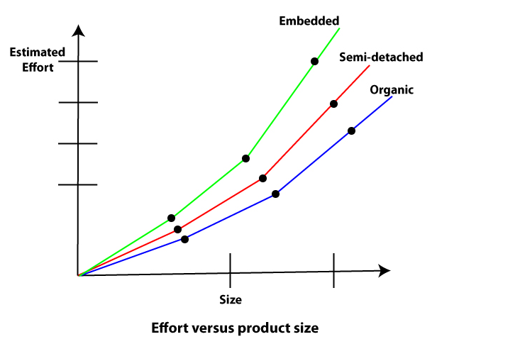
Some insight into the basic COCOMO model can be obtained by plotting the estimated characteristics for different software sizes.
Fig shows a plot of estimated effort versus product size.
From fig, we can observe that the effort is somewhat superliner in the size of the software product. Thus, the effort required to develop a product increases very rapidly with project size.

Slide 15
The development time versus the product size in KLOC is plotted in fig.
From fig it can be observed that the development time is a sub linear function of the size of the product, i.e. when the size of the product increases by two times, the time to develop the product does not double but rises moderately.
This can be explained by the fact that for larger products, a larger number of activities which can be carried out concurrently can be identified.
The parallel activities can be carried out simultaneously by the engineers. This reduces the time to complete the project.
Further, from fig, it can be observed that the development time is roughly the same for all three categories of products.

Slide 16
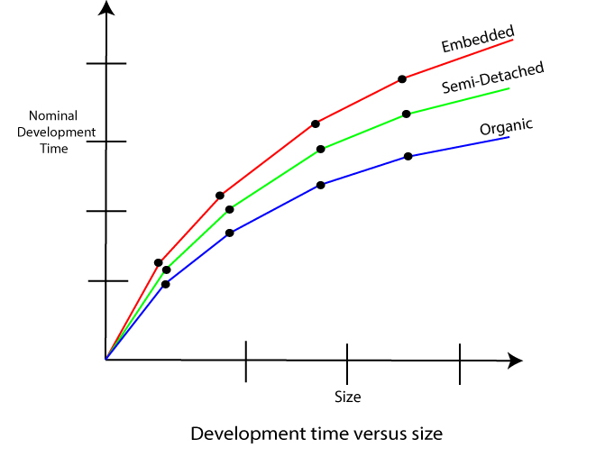
For example, a 60 KLOC program can be developed in approximately 18 months, regardless of whether it is of organic, semidetached, or embedded type

Slide 17
From the effort estimation, the project cost can be obtained by multiplying the required effort by the manpower cost per month.
But, implicit in this project cost computation is the assumption that the entire project cost is incurred on account of the manpower cost alone.
In addition to manpower cost, a project would incur costs due to hardware and software required for the project and the company overheads for administration, office space, etc.
It is important to note that the effort and the duration estimations obtained using the COCOMO model are called a nominal effort estimate and nominal duration estimate.
The term nominal implies that if anyone tries to complete the project in a time shorter than the estimated duration, then the cost will increase drastically.
But, if anyone completes the project over a longer period of time than the estimated, then there is almost no decrease in the estimated cost value.

Slide 18
Example1: Suppose a project was estimated to be 400 KLOC. Calculate the effort and development time for each of the three model i.e., organic, semi-detached & embedded.
Solution: The basic COCOMO equation takes the form:
Effort=a₁*(KLOC) a₂ PM Tdev=b₁*(efforts)b₂ Months Estimated Size of project= 400 KLOC
(i)Organic Mode
E = 2.4 * (400)1.05 = 1295.31 PM D = 2.5 * (1295.31)0.38=38.07 PM
(ii)Semidetached Mode
E = 3.0 * (400)1.12=2462.79 PM D = 2.5 * (2462.79)0.35=38.45 PM
(iii) Embedded Mode
E = 3.6 * (400)1.20 = 4772.81 PM D = 2.5 * (4772.8)0.32 = 38 PM

Slide 19
Example2: A project size of 200 KLOC is to be developed. Software development team has average experience on similar type of projects. The project schedule is not very tight. Calculate the Effort, development time, average staff size, and productivity of the project.
Solution: The semidetached mode is the most appropriate mode, keeping in view the size, schedule and experience of development time.
Hence E=3.0(200)1.12=1133.12PM D=2.5(1133.12)0.35=29.3PM
P = 176 LOC/PM

Slide 20
2. Intermediate Model:
The basic Cocomo model considers that the effort is only a function of the number of lines of code and some constants calculated according to the various software systems.
The intermediate COCOMO model recognizes these facts and refines the initial estimates obtained through the basic COCOMO model by using a set of 15 cost drivers based on various attributes of software engineering.

Slide 21
Classification of Cost Drivers and their attributes:
(i) Product attributes -
Required software reliability extent
Size of the application database
The complexity of the product
Hardware attributes -
Run-time performance constraints
Memory constraints
The volatility of the virtual machine environment
Required turnabout time

Slide 22
Personnel attributes -
Analyst capability
Software engineering capability
Applications experience
Virtual machine experience
Programming language experience
Project attributes -
Use of software tools
Application of software engineering methods
Required development schedule

Slide 23
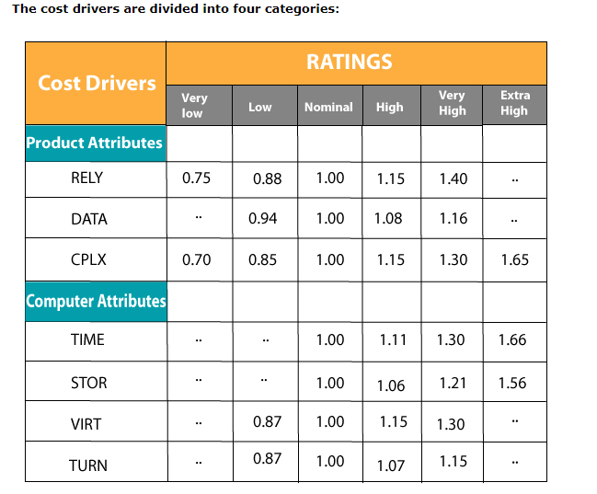

Slide 24
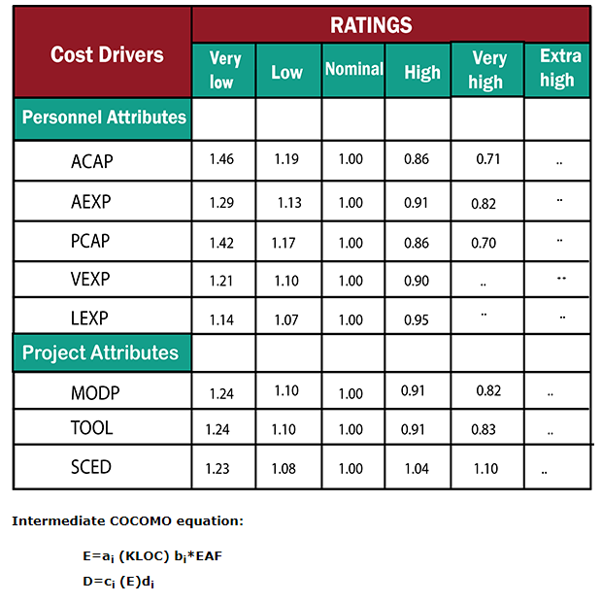

Slide 25
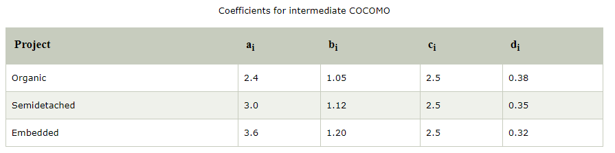

Slide 26
3. Detailed COCOMO Model:
Detailed COCOMO incorporates all qualities of the standard version with an assessment of the cost drivers effect on each method of the software engineering process.
The detailed model uses various effort multipliers for each cost driver property.
In detailed cocomo, the whole software is differentiated into multiple modules, and then we apply COCOMO in various modules to estimate effort and then sum the effort.

Slide 27
The Six phases of detailed COCOMO are:
Planning and requirements
System structure
Complete structure
Module code and test
Integration and test
Cost Constructive model
The effort is determined as a function of program estimate, and a set of cost drivers are given according to every phase of the software lifecycle.

Slide 28
Quality Management
Software Quality Management
It is a term used to describe the management aspects of developing quality software.
SQM begins with an idea for a product and continues through the design, testing and launch phases.
A management process that is made up of a few different steps, SQM can be broken down most simply into three phases:
Quality planning, assurance and control.

Slide 29
Quality Planning
Before software development begins, quality planning must take place. Quality planning involves the creation of goals and objectives for your software, as well as the creation of a strategic plan that will help you to successfully meet the objectives you lay out.
Quality planning is often considered the most important aspect of SQM, as it develops a strong blueprint for the rest of the process to follow leading to the best-possible end product.
Quality Assurance
The quality assurance phase of SQM involves the actual building of the software program.
With good SQM in place, product performance will be checked along the way to ensure that all standards are being followed. Audits may be performed and data will be collected throughout the entirety of the process.

Slide 30
Quality Control
The step of SQM where testing finally comes into play, quality control is in place to discover bugs, evaluate functionality and more.
Depending on the results of the quality control phase, you may need to go back to development to iron out kinks and make some small final adjustments.
Having a software quality management plan in place can guarantee that all industry standards are being followed and that your end-user will receive a well-developed, high quality product.

Slide 31
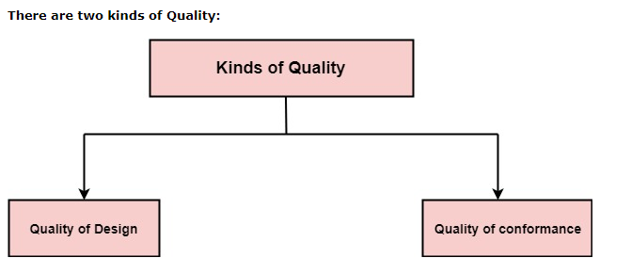
Quality Concepts
Quality:
Quality defines to any measurable characteristics such as correctness, maintainability, portability, testability, usability, reliability, efficiency, integrity, reusability, and interoperability.

Slide 32
Quality of Design:
Quality of Design refers to the characteristics that designers specify for an item.
The grade of materials, tolerances, and performance specifications that all contribute to the quality of design.
Quality of conformance:
Quality of conformance is the degree to which the design specifications are followed during manufacturing.
Greater the degree of conformance, the higher is the level of quality of conformance.

Slide 33
Software Quality: Software Quality is defined as the conformance to explicitly state functional and performance requirements, explicitly documented development standards, and inherent characteristics that are expected of all professionally developed software.
Quality Control: Quality Control involves a series of inspections, reviews, and tests used throughout the software process to ensure each work product meets the requirements place upon it. Quality control includes a feedback loop to the process that created the work product.
Quality Assurance: Quality Assurance is the preventive set of activities that provide greater confidence that the project will be completed successfully.

Slide 34
Quality Assurance focuses on how the engineering and management activity will be done
As anyone is interested in the quality of the final product, it should be assured that we are building the right product.
It can be assured only when we do inspection & review of intermediate products, if there are any bugs, then it is debugged. This quality can be enhanced.
Importance of Quality
We would expect the quality to be a concern of all producers of goods and services. However, the distinctive characteristics of software and in particular its intangibility and complexity, make special demands.

Slide 35
Increasing criticality of software: The final customer or user is naturally concerned about the general quality of software, especially its reliability. This is increasing in the case as organizations become more dependent on their computer systems and software is used more and more in safety-critical areas. For example, to control aircraft.
The intangibility of software: This makes it challenging to know that a particular task in a project has been completed satisfactorily. The results of these tasks can be made tangible by demanding that the developers produce 'deliverables' that can be examined for quality.
Accumulating errors during software development: As computer system development is made up of several steps where the output from one level is input to the next, the errors in the earlier ?deliverables? will be added to those in the later stages leading to accumulated determinable effects. In general the later in a project that an error is found, the more expensive it will be to fix. In addition, because the number of errors in the system is unknown, the debugging phases of a project are particularly challenging to control.

Slide 36
Software Quality Assurance
Software quality assurance is a planned and systematic plan of all actions necessary to provide adequate confidence that an item or product conforms to establish technical requirements.
A set of activities designed to calculate the process by which the products are developed or manufactured.
SQA Encompasses
A quality management approach
Effective Software engineering technology (methods and tools)
Formal technical reviews that are tested throughout the software process
A multitier testing strategy
Control of software documentation and the changes made to it.
A procedure to ensure compliances with software development standards
Measuring and reporting mechanisms.

Slide 37
SQA Activities
Software quality assurance is composed of a variety of functions associated with two different constituencies , the software engineers who do technical work and an SQA group that has responsibility for quality assurance planning, record keeping, analysis, and reporting.
Following activities are performed by an independent SQA group:
Prepares an SQA plan for a project:
The program is developed during project planning and is reviewed by all stakeholders.
The plan governs quality assurance activities performed by the software engineering team and the SQA group.
The plan identifies calculation to be performed, audits and reviews to be performed, standards that apply to the project, techniques for error reporting and tracking, documents to be produced by the SQA team, and amount of feedback provided to the software project team.

Slide 38
Participates in the development of the project's software process description: The software team selects a process for the work to be performed. The SQA group reviews the process description for compliance with organizational policy, internal software standards, externally imposed standards (e.g. ISO-9001), and other parts of the software project plan.
Reviews software engineering activities to verify compliance with the defined software process: The SQA group identifies, reports, and tracks deviations from the process and verifies that corrections have been made.
Audits designated software work products to verify compliance with those defined as a part of the software process: The SQA group reviews selected work products, identifies, documents and tracks deviations, verify that corrections have been made, and periodically reports the results of its work to the project manager.

Slide 39
Ensures that deviations in software work and work products are documented and handled according to a documented procedure: Deviations may be encountered in the project method, process description, applicable standards, or technical work products.
Records any noncompliance and reports to senior management: Non- compliance items are tracked until they are resolved.

Slide 40
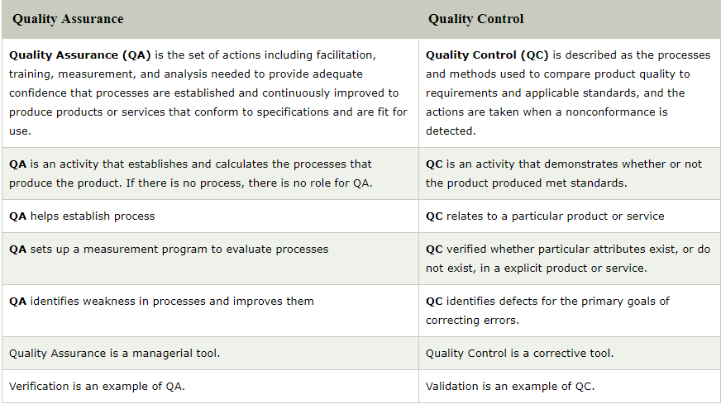

Slide 41
Software Reviews:
A software review is a process or meeting during which a software product is examined by a project personnel, managers, users, customers, user representatives, or other interested parties for comment or approval.
Formal Review:
Formal reviews follow a formal process. It is well structured and regulated. A formal review process consists of six main steps:
Planning
Kick-off
Preparation
Review meeting
Rework
Follow-up

Slide 42
1. Planning
The first phase of the formal review is the Planning phase. In this phase thereview process begins with a request for review by the author to the moderator (or inspection leader).
A moderator has to take care of the scheduling like date, time, place and invitation of the review. For the formal reviews the moderator performs the entry check and also defines the formal exit criteria.
The entry check is done to ensure that the reviewer’s time is not wasted on a document that is not ready for review.
After doing the entry check if the document is found to have very little defects then it’s ready to go for the reviews.
So, the entry criteria are to check that whether the document is ready to enter the formal review process or not. Hence the entry criteria for any document to go for the reviews are:

Slide 43
The documents should not reveal a large number of major defects.
The documents to be reviewed should be with line numbers.
The documents should be cleaned up by running any automated checks that apply.
The author should feel confident about the quality of the document so that he can join the review team with that document.
Once, the document clear the entry check the moderator and author decides that which part of the document is to be reviewed.
Since the human mind can understand only a limited set of pages at one time so in a review the maximum size is between 10 and 20 pages.
Hence checking the documents improves the moderator ability to lead the meeting because it ensures the better understanding.

Slide 44
2. Kick-off:
This kick-off meeting is an optional step in a review procedure.
The goal of this step is to give a short introduction on the objectives of the review and the documents to everyone in the meeting.
The relationships between the document under review and the other documents are also explained, especially if the numbers of related documents are high.

Slide 45
Preparation:
In this step the reviewers review the document individually using the related documents, procedures, rules and checklists provided.
Each participant while reviewing individually identifies the defects, questions and comments according to their understanding of the document and role.
After that all issues are recorded using a logging form.
The success factor for a thorough preparation is the number of pages checked per hour.
This is called the checking rate.
Usually the checking rate is in the range of 5 to 10 pages per hour.

Slide 46
Review meeting:
The review meeting consists of three phases:
Logging phase: In this phase the issues and the defects that have been identified during the preparation step are logged page by page. The logging is basically done by the author or by a scribe. Scribe is a separate person to do the logging and is especially useful for the formal review types such as an inspection.
Every defects and it’s severity should be logged in any of the three severity classes given below:
Critical:The defects will cause downstream damage.
Major: The defects could cause a downstream damage. Minor: The defects are highly unlikely to cause the downstream damage.

Slide 47
During the logging phase the moderator focuses on logging as many defects as possible within a certain time frame and tries to keep a good logging rate (number of defects logged per minute).
In formal review meeting the good logging rate should be between one and two defects logged per minute.
Discussion phase:
If any issue needs discussion then the item is logged and then handled in the discussion phase.
As chairman of the discussion meeting, the moderator takes care of the people issues and prevents discussion from getting too personal and calls for a break to cool down the heated discussion.
The outcome of the discussions is documented for the future reference.

Slide 48
Decision phase:
At the end of the meeting a decision on the document under review has to be made by the participants, sometimes based on formal exit criteria.
Exit criteria are the average number of critical and/or major defects found per page (for example no more than three critical/major defects per page).
If the number of defects found per page is more than a certain level then the document must be reviewed again, after it has been reworked.

Slide 49
5. Rework:
In this step if the number of defects found per page exceeds the certain level then the document has to be reworked.
Not every defect that is found leads to rework. It is the author’s responsibility to judge whether the defect has to be fixed.
If nothing can be done about an issue then at least it should be indicated that the author has considered the issue.
6. Follow-up:
In this step the moderator check to make sure that the author has taken action on all known defects.
If it is decided that all participants will check the updated documents then the moderator takes care of the distribution and collects the feedback.
It is the responsibility of the moderator to ensure that the information is correct and stored for future analysis.

Slide 50
Informal Reviews:
Informal reviews are applied many times during the early stages of the life cycle of the document.
A two person team can conduct an informal review.
In later stages these reviews often involve more people and a meeting.
The goal is to keep the author and to improve the quality of the document.
The most important thing to keep in mind about the informal reviews is that they are not documented.

Slide 51
Technical Review:
It is less formal review
It is led by the trained moderator but can also be led by a technical expert
It is often performed as a peer review without management participation
Defects are found by the experts (such as architects, designers, key users) who focus on the content of the document.
In practice, technical reviews vary from quite informal to very formal
The goals of the technical review are:
To ensure that an early stage the technical concepts are used correctly
To access the value of technical concepts and alternatives in the product
To have consistency in the use and representation of technical concepts
To inform participants about the technical content of the document

Slide 52
Walkthroughs :
Walkthroughs are represented by the below characteristics:
It is not a formal process/review
It is led by the authors
Author guide the participants through the document according to his or her thought process to achieve a common understanding and to gather feedback.
Useful for the people if they are not from the software discipline, who are not used to or cannot easily understand software development process.
Is especially useful for higher level documents like requirement specification, etc.

Slide 53
The goals of a walkthrough:
To present the documents both within and outside the software discipline in order to gather the information regarding the topic under documentation.
To explain or do the knowledge transfer and evaluate the contents of the document
To achieve a common understanding and to gather feedback.
To examine and discuss the validity of the proposed solutions

Slide 54
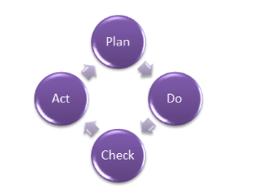
Formal approaches of SQA
Quality assurance has a defined cycle called PDCA cycle or Deming cycle. The phases of this cycle are:
Plan
Do
Check
Act
These above steps are repeated to ensure that processes followed in the organization are evaluated and improved on a periodic basis.
Let's look into the above steps in detail
Plan - Organization should plan and establish the process related objectives and determine the processes that are required to deliver a high-Quality end product.
Do - Development and testing of Processes and also "do" changes in the processes

Slide 55
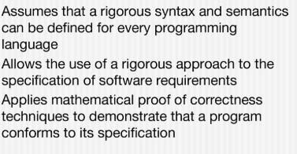
Check - Monitoring of processes, modify the processes, and check whether it meets the predetermined objectives
Act - Implement actions that are necessary to achieve improvements in the processes
An organization must use Quality Assurance to ensure that the product is designed and implemented with correct procedures. This helps reduce problems and errors, in the final product.
Formal SQA

Slide 56
SQA Approaches
1.Proof of correctness.
2.Statistical quality assurance.
3.Cleanroom process combines items 1 & 2
A proof of correctness is a mathematical proof that a computer program or a part thereof will, when executed, yield correct results i.e., results fulfilling specific requirements. Before proving a program correct, the theorem to be proved must, of course, be formulated.
Hypothesis: The hypothesis of such a correctness theorem is typically a condition that the relevant program variables must satisfy immediately “before” the program is executed. This condition is called the “precondition”.
Thesis: The thesis of the correctness theorem is typically a condition that the relevant program variables must satisfy immediately “after” execution of the program. This latter condition is called the ‘post-condition’.

Slide 57
Thus the correctness theorem can be stated as:
“If the condition, “V”, is true before execution of the program, “S”, then the condition, “P”, will be true after execution of “S” “.
Where “V” is pre-condition and “P” is post-condition.
Statistical quality assurance.
Traditional compliance testing techniques can sometimes provide limited pass/fail information, which results in insufficient measurements on the batch’s quality control, identification of the root cause of failure results and overall quality assurance (QA) in the production process.

Slide 58
Intertek combines legal, customer and essential safety requirements to customize a workable QA process, called Statistical Quality Assurance (SQA).
SQA is used to identify the potential variations in the manufacturing process and predict potential defects on a parts-per-million (PPM) basis.
It provides a statistical description of the final product and addresses quality and safety issues that arise during manufacturing.
SQA consists of three major methodologies:
Force Diagram - A Force Diagram describes how a product should be tested. Intertek engineers base the creation of Force Diagrams on our knowledge of foreseeable use, critical manufacturing process and critical components that have high potential to fail.

Slide 59
Test-to-Failure (TTF) - Unlike any legal testing, TTF tells manufacturers on how many defects they are likely to find in every million units of output. This information is incorporated into the process and concludes if a product needs improvement in quality or if it is being over engineered, which will eventually lead to cost savings.
Intervention - Products are separated into groups according to the total production quantity and production lines. Each group then undergoes an intervention. The end result is measured by Z-value, which is the indicator of quality and consistency of a product to a specification. Intervention allows manufacturers to pinpoint a defect to a specific lot and production line; thus saving time and money in corrective actions.

Slide 60
Software Reliability
Software Reliability Models
A software reliability model indicates the form of a random process that defines the behavior of software failures to time.
Software reliability models have appeared as people try to understand the features of how and why software fails, and attempt to quantify software reliability.
There is no individual model that can be used in all situations. No model is complete or even representative.
Most software models contain the following parts:
Assumptions
Factors
A mathematical function that includes the reliability with the elements. The mathematical function is generally higher-order exponential or logarithmic.

Slide 61
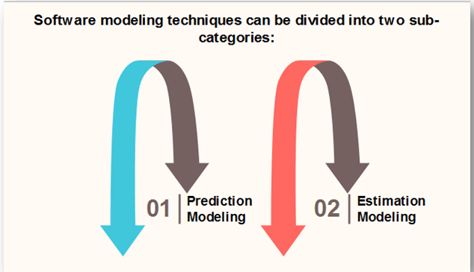

Slide 62
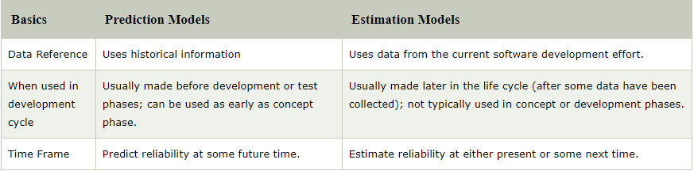
Both kinds of modeling methods are based on observing and accumulating failure data and analyzing with statistical inference.
Differentiate between software reliability prediction models and software reliability estimation models.

Slide 63
Reliability Models
A reliability growth model is a numerical model of software reliability, which predicts how software reliability should improve over time as errors are discovered and repaired.
These models help the manager in deciding how much efforts should be devoted to testing.
The objective of the project manager is to test and debug the system until the required level of reliability is reached.

Slide 64
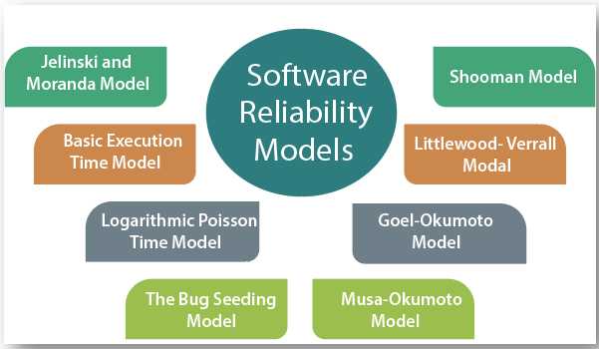
Following are the Software Reliability Models are:

Slide 65
Software Maintenance:
Software maintenance is widely accepted part of SDLC now a days. It stands for all the modifications and updations done after the delivery of software product.
There are number of reasons, why modifications are required, some of them are briefly mentioned below:
Market Conditions - Policies, which changes over the time, such as taxation and newly introduced constraints like, how to maintain bookkeeping, may trigger need for modification.
Client Requirements - Over the time, customer may ask for new features or functions in the software.

Slide 66
Host Modifications - If any of the hardware and/or platform (such as operating system) of the target host changes, software changes are needed to keep adaptability.
Organization Changes - If there is any business level change at client end, such as reduction of organization strength, acquiring another company, organization venturing into new business, need to modify in the original software may arise.
Types of maintenance
In a software lifetime, type of maintenance may vary based on its nature.
It may be just a routine maintenance tasks as some bug discovered by some user or it may be a large event in itself based on maintenance size or nature.

Slide 67
Corrective Maintenance - This includes modifications and updations done in order to correct or fix problems, which are either discovered by user or concluded by user error reports.
Adaptive Maintenance - This includes modifications and updations applied to keep the software product up-to date and tuned to the ever changing world of technology and business environment.
Perfective Maintenance - This includes modifications and updates done in order to keep the software usable over long period of time. It includes new features, new user requirements for refining the software and improve its reliability and performance.
Preventive Maintenance - This includes modifications and updations to prevent future problems of the software. It aims to attend problems, which are not significant at this moment but may cause serious issues in future.

Slide 68
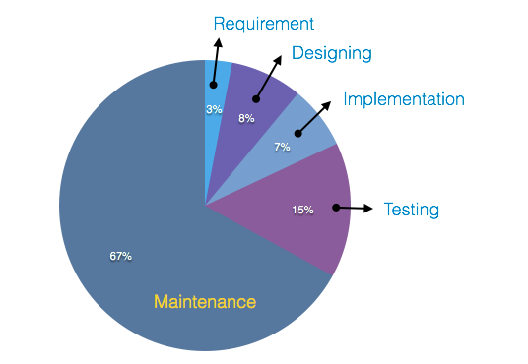
Cost of Maintenance
Reports suggest that the cost of maintenance is high. A study on estimating software maintenance found that the cost of maintenance is as high as 67% of the cost of entire software process .
On an average, the cost of software maintenance is more than 50% of all SDLC phases. There are various factors, which trigger maintenance cost go high, such as:

Slide 69
Real-world factors affecting Maintenance Cost
The standard age of any software is considered up to 10 to 15 years.
Older softwares, which were meant to work on slow machines with less memory and storage capacity cannot keep themselves challenging against newly coming enhanced softwares on modern hardware.
As technology advances, it becomes costly to maintain old software.
Most maintenance engineers are newbie and use trial and error method to rectify problem.
Often, changes made can easily hurt the original structure of the software, making it hard for any subsequent changes.
Changes are often left undocumented which may cause more conflicts in future.

Slide 70
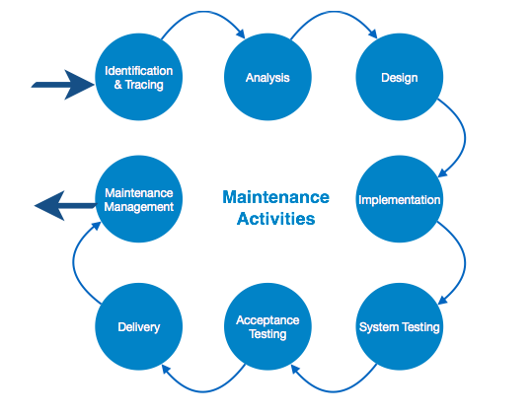
Software-end factors affecting Maintenance Cost
Structure of Software Program
Programming Language
Dependence on external environment
Staff reliability and availability
Maintenance Activities
IEEE provides a framework for sequential maintenance process activities. It can be used in iterative manner and can be extended so that customized items and processes can be include.

Slide 71
These activities go hand-in-hand with each of the following phase:
Identification & Tracing - It involves activities pertaining to identification of requirement of modification or maintenance. It is generated by user or system may itself report via logs or error messages.Here, the maintenance type is classified also.
Analysis - The modification is analyzed for its impact on the system including safety and security implications. If probable impact is severe, alternative solution is looked for. A set of required modifications is then materialized into requirement specifications. The cost of modification/maintenance is analyzed and estimation is concluded.
Design - New modules, which need to be replaced or modified, are designed against requirement specifications set in the previous stage. Test cases are created for validation and verification.

Slide 72
Implementation - The new modules are coded with the help of structured design created in the design step.Every programmer is expected to do unit testing in parallel.
System Testing - Integration testing is done among newly created modules. Integration testing is also carried out between new modules and the system. Finally the system is tested as a whole, following regressive testing procedures.
Acceptance Testing - After testing the system internally, it is tested for acceptance with the help of users. If at this state, user complaints some issues they are addressed or noted to address in next iteration.
Delivery - After acceptance test, the system is deployed all over the organization either by small update package or fresh installation of the system. The final testing takes place at client end after the software is delivered. Training facility is provided if required, in addition to the hard copy of user manual.
Maintenance management - Configuration management is an essential part of system maintenance. It is aided with version control tools to control versions, semi-version or patch management.

Slide 73
Software Configuration Management and Need
Software Configuration Management is defined as a process to systematically manage, organize, and control the changes in the documents, codes, and other entities during the Software Development Life Cycle.
It is abbreviated as the SCM process in software engineering.
The primary goal is to increase productivity with minimal mistakes.
Need of Configuration management:
The primary reasons for Implementing Software Configuration Management System are:
There are multiple people working on software which is continually updating
It may be a case where multiple version, branches, authors are involved in a software project, and the team is geographically distributed and works concurrently

Slide 74
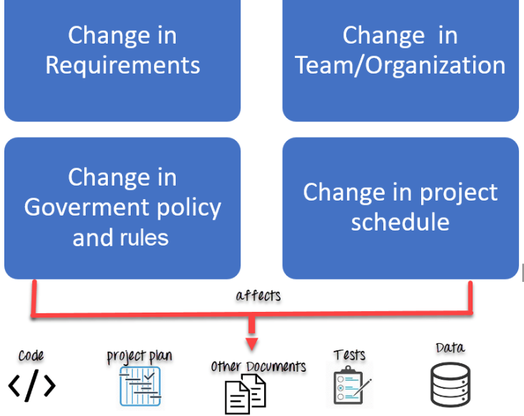
Changes in user requirement, policy, budget, schedule need to be accommodated.
Software should able to run on various machines and Operating Systems
Helps to develop coordination among stakeholders
SCM process is also beneficial to control the costs involved in making changes to a system

Slide 75
Any change in the software configuration Items will affect the final product.
Therefore, changes to configuration items need to be controlled and managed.

Slide 76
Version Control:
Version Control
Software Version Control is a system or tool that captures the changes to a source code elements: files, folders, images or binaries.
A version control system (also known as a Revision Control System) is a repository of files, often the files for the source code of computer programs, with monitored access.
Every change made to the source is tracked, along with who made the change, why they made it, and references to problems fixed, or enhancements introduced, by the change.
Version control systems are essential for any form of distributed, collaborative development.

Slide 77
Whether it is the history of a wiki page or large software development project, the ability to track each change as it was made, and to reverse changes when necessary can make all the difference between a well managed and controlled process and an uncontrolled ‘first come, first served’ system.
It can also serve as a mechanism for due diligence for software projects.
Combines procedures and tools to manage the different versions of configuration objects created during the software process.

Slide 78
Version control systems require the following capabilities.
Project repository – stores all relevant configuration objects.
Version management capability – stores all versions of a configuration object (enables any version to be built from past versions)
Make facility – enables collection of all relevant configuration objects and construct a specific software version.
Issues (bug) tracking capability – enables team to record and track status of outstanding issues for each configuration object.
Uses a system modeling approach (template – includes component hierarchy and component build order, construction rules, verification rules).

Slide 79
SCM process
Tasks in SCM process
Configuration Identification
Baselines
Change Control
Configuration Status Accounting
Configuration Audits and Reviews

Slide 80
Configuration Identification:
Configuration identification is a method of determining the scope of the software system.
With the help of this step, you can manage or control something even if you don't know what it is.
It is a description that contains the CSCI type (Computer Software Configuration Item), a project identifier and version information.
Activities during this process:
Identification of configuration Items like source code modules, test case, and requirements specification.

Slide 81
Identification of each CSCI in the SCM repository, by using an object-oriented approach
The process starts with basic objects which are grouped into aggregate objects.
Details of what, why, when and by whom changes in the test are made
Every object has its own features that identify its name that is explicit to all other objects
List of resources required such as the document, the file, tools, etc.
Example:
Instead of naming a File login.php its should be named login_v1.2.php where v1.2 stands for the version number of the file
Instead of naming folder "Code" it should be named "Code_D" where D represents code should be backed up daily.

Slide 82
Baseline:
A baseline is a formally accepted version of a software configuration item.
It is designated and fixed at a specific time while conducting the SCM process.
It can only be changed through formal change control procedures.
Activities during this process:
Facilitate construction of various versions of an application
Defining and determining mechanisms for managing various versions of these work products
The functional baseline corresponds to the reviewed system requirements
Widely used baselines include functional, developmental, and product baselines
In simple words, baseline means ready for release.

Slide 83
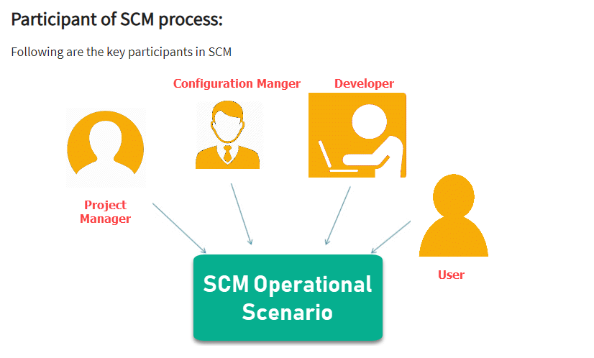

Slide 84
Change Control:
Change control is a procedural method which ensures quality and consistency when changes are made in the configuration object.
In this step, the change request is submitted to software configuration manager.
Activities during this process:
Control ad-hoc change to build stable software development environment.
Changes are committed to the repository
The request will be checked based on the technical merit, possible side effects and overall impact on other configuration objects.
It manages changes and making configuration items available during the software lifecycle

Slide 85
Configuration Status Accounting:
Configuration status accounting tracks each release during the SCM process.
This stage involves tracking what each version has and the changes that lead to this version.
Activities during this process:
Keeps a record of all the changes made to the previous baseline to reach a new baseline
Identify all items to define the software configuration
Monitor status of change requests
Complete listing of all changes since the last baseline
Allows tracking of progress to next baseline
Allows to check previous releases/versions to be extracted for testing

Slide 86
Configuration Audits and Reviews:
Software Configuration audits verify that all the software product satisfies the baseline needs.
It ensures that what is built is what is delivered.
Activities during this process:
Configuration auditing is conducted by auditors by checking that defined processes are being followed and ensuring that the SCM goals are satisfied
To verify compliance with configuration control standards. auditing and reporting the changes made
SCM audits also ensure that traceability is maintained during the process.
Ensures that changes made to a baseline comply with the configuration status reports
Validation of completeness and consistency

Slide 87
1. Configuration Manager
Configuration Manager is the head who is Responsible for identifying configuration items.
CM ensures team follows the SCM process
He/She needs to approve or reject change requests
2. Developer
The developer needs to change the code as per standard development activities or change requests.
He is responsible for maintaining configuration of code.
The developer should check the changes and resolves conflicts

Slide 88
3. Auditor
The auditor is responsible for SCM audits and reviews.
Need to ensure the consistency and completeness of release.
4. Project Manager:
Ensure that the product is developed within a certain time frame
Monitors the progress of development and recognizes issues in the SCM process
Generate reports about the status of the software system
Make sure that processes and policies are followed for creating, changing, and testing
5. User
The end user should understand the key SCM terms to ensure he has the latest version of the software

Slide 89
Software Configuration Management Plan
The SCMP (Software Configuration management planning) process planning begins at the early phases of a project. The outcome of the planning phase is the SCM plan which might be stretched or revised during the project.
The SCMP can follow a public standard like the IEEE 828 or organization specific standard
It defines the types of documents to be management and a document naming. Example Test_v1
SCMP defines the person who will be responsible for the entire SCM process and creation of baselines.
Fix policies for version management & change control
Define tools which can be used during the SCM process
Configuration management database for recording configuration information.

Slide 90
Software Configuration Management Tools
Any Change management software should have the following 3 Key features:
Concurrency Management:
When two or more tasks are happening at the same time, it is known as concurrent operation.
Concurrency in context to SCM means that the same file being edited by multiple persons at the same time.
If concurrency is not managed correctly with SCM tools, then it may create many pressing issues.

Slide 91
Synchronization:
Users can checkout more than one files or an entire copy of the repository.
The user then works on the needed file and checks in the changes back to the repository.
They can synchronize their local copy to stay updated with the changes made by other team members.
Following are popular tools
1. Git: Git is a free and open source tool which helps version control. It is designed to handle all types of projects with speed and efficiency.
2. Team Foundation Server: Team Foundation is a group of tools and technologies that enable the team to collaborate and coordinate for building a product.
3. Ansible: It is an open source Software configuration management tool. Apart from configuration management it also offers application deployment & task automation.

Slide 92
Software Re-engineering
When we need to update the software to keep it to the current market, without impacting its functionality, it is called software re-engineering.
It is a thorough process where the design of software is changed and programs are re-written.
Legacy software cannot keep tuning with the latest technology available in the market.
As the hardware become obsolete, updating of software becomes a headache.
Even if software grows old with time, its functionality does not.

Slide 93
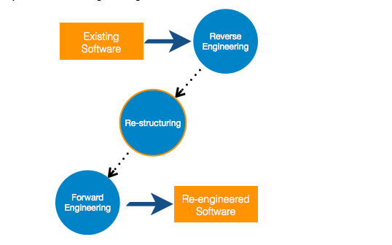
For example, initially Unix was developed in assembly language.
When language C came into existence, Unix was re-engineered in C, because working in assembly language was difficult.
Other than this, sometimes programmers notice that few parts of software need more maintenance than others and they also need re-engineering.

Slide 94
Re-Engineering Process
Decide what to re-engineer. Is it whole software or a part of it?
Perform Reverse Engineering, in order to obtain specifications of existing software.
Restructure Program if required. For example, changing function-oriented programs into object-oriented programs.
Re-structure data as required.
Apply Forward engineering concepts in order to get re-engineered software.

Slide 95

Reverse Engineering:
It is a process to achieve system specification by thoroughly analyzing, understanding the existing system.
This process can be seen as reverse SDLC model, i.e. we try to get higher abstraction level by analyzing lower abstraction levels.
An existing system is previously implemented design, about which we know nothing.
Designers then do reverse engineering by looking at the code and try to get the design.
With design in hand, they try to conclude the specifications. Thus, going in reverse from code to system specification.

Slide 96
Restructuring:
It is a process to re-structure and re-construct the existing software.
It is all about re-arranging the source code, either in same programming language or from one programming language to a different one.
Restructuring can have either source code-restructuring and data-restructuring or both.
Re-structuring does not impact the functionality of the software but enhance reliability and maintainability.
Program components, which cause errors very frequently can be changed, or updated with re-structuring.
The dependability of software on obsolete hardware platform can be removed via re-structuring.

Slide 97
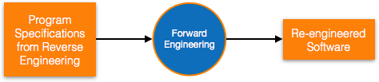
Forward Engineering
Forward engineering is a process of obtaining desired software from the specifications in hand which were brought down by means of reverse engineering.
It assumes that there was some software engineering already done in the past.
Forward engineering is same as software engineering process with only one difference – it is carried out always after reverse engineering.

Slide 98
Component reusability
A component is a part of software program code, which executes an independent task in the system. It can be a small module or sub-system itself.
Example:
The login procedures used on the web can be considered as components, printing system in software can be seen as a component of the software.
Components have high cohesion of functionality and lower rate of coupling, i.e. they work independently and can perform tasks without depending on other modules.
In OOP, the objects are designed are very specific to their concern and have fewer chances to be used in some other software.

Slide 99
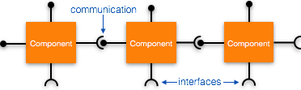
In modular programming, the modules are coded to perform specific tasks which can be used across number of other software programs.
There is a whole new vertical, which is based on re-use of software component, and is known as Component Based Software Engineering (CBSE).

Slide 100
Re-use can be done at various levels
Application level - Where an entire application is used as sub-system of new software.
Component level - Where sub-system of an application is used.
Modules level - Where functional modules are re-used.
Software components provide interfaces, which can be used to establish communication among different components.

Slide 101
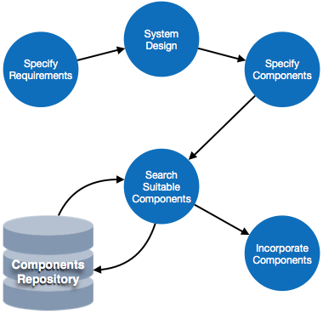
Reuse Process:
Two kinds of method can be adopted: either by keeping requirements same and adjusting components or by keeping components same and modifying requirements.

Slide 102
Requirement Specification - The functional and non-functional requirements are specified, which a software product must comply to, with the help of existing system, user input or both.
Design - This is also a standard SDLC process step, where requirements are defined in terms of software parlance. Basic architecture of system as a whole and its sub-systems are created.
Specify Components - By studying the software design, the designers segregate the entire system into smaller components or sub-systems. One complete software design turns into a collection of a huge set of components working together.
Search Suitable Components - The software component repository is referred by designers to search for the matching component, on the basis of functionality and intended software requirements.
Incorporate Components - All matched components are packed together to shape them as complete software.

Slide 103
Thank you

